Slide 1
Independent Sizing of Battery Racks & Cabinets
Short description and important features
Notes:
<Foliennummer>

Slide 2
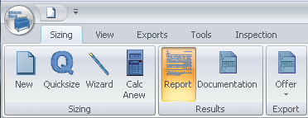
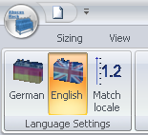
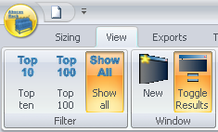
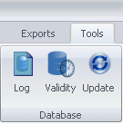
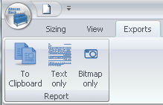
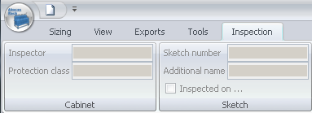
AbacusRack: User Interface design
Language selection
Modern Ribbon Bars instead of Menüs
Database tools
Presentation of results very variable
Multiple Documents simultaneously
Exports and Inspection mode
<Foliennummer>

Slide 3
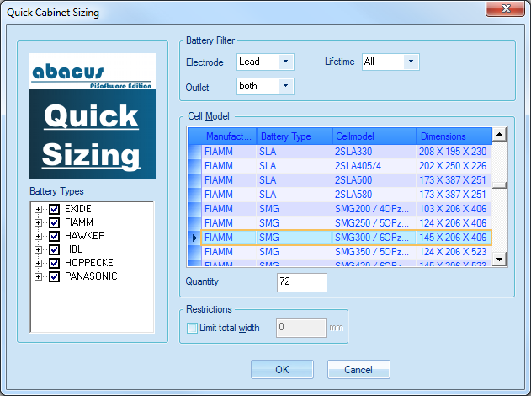
AbacusRack: Quick Sizing Wizard
Filter for
Battery type
Elektrode type
Life time
Ventilation
Select Cell Model to store
Select database (e.g. manufacturer)
Select Battery Type to store
Input number of cells to store
<Foliennummer>

Slide 4
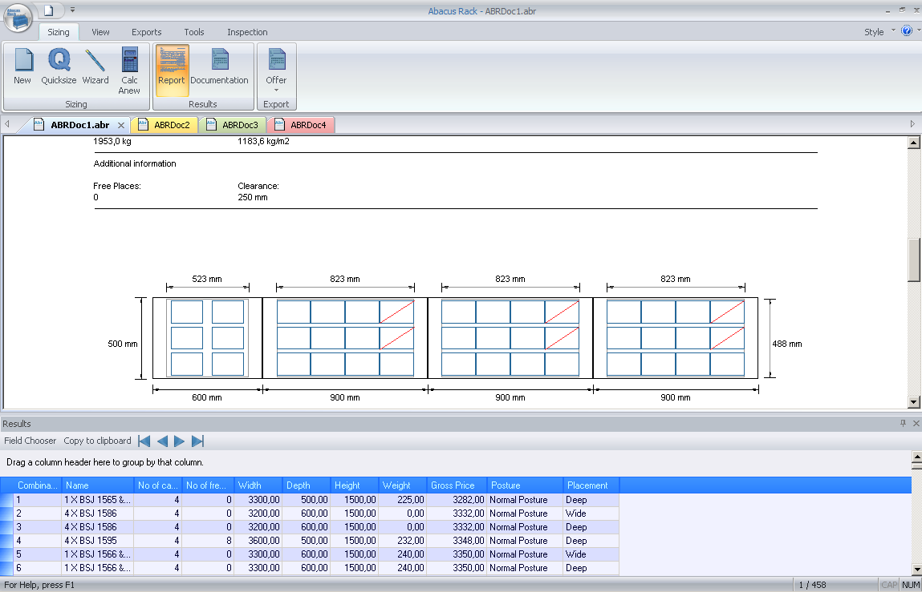
AbacusRack: Result List
Lower part: Clear list of possible combinations
Upper part: Selected Result
Data and Drawing
Sortable , Groupable and Exportable
<Foliennummer>

Slide 5
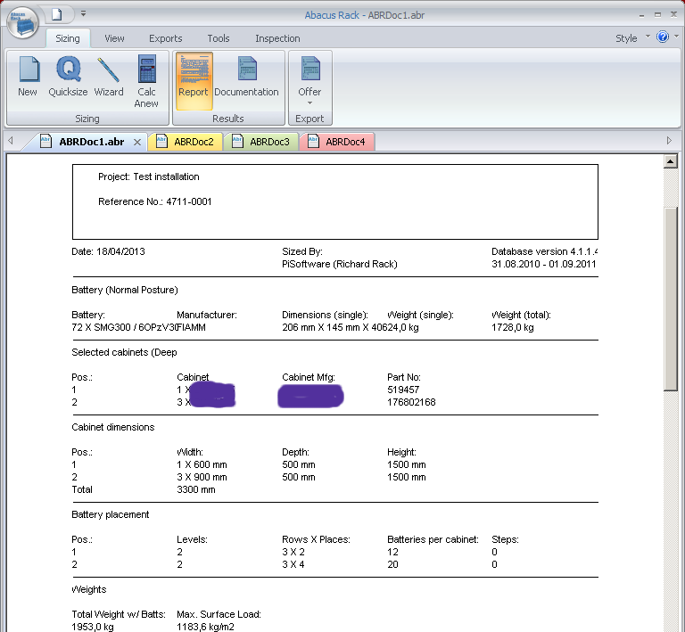
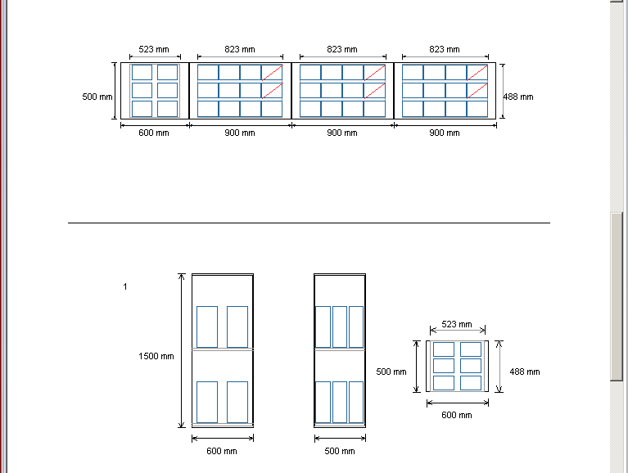
AbacusRack: Report
Header
Rack or Cabinet data
Groundplan drawing
Drawing for every Rack and Cabinet in use
<Foliennummer>

Slide 6
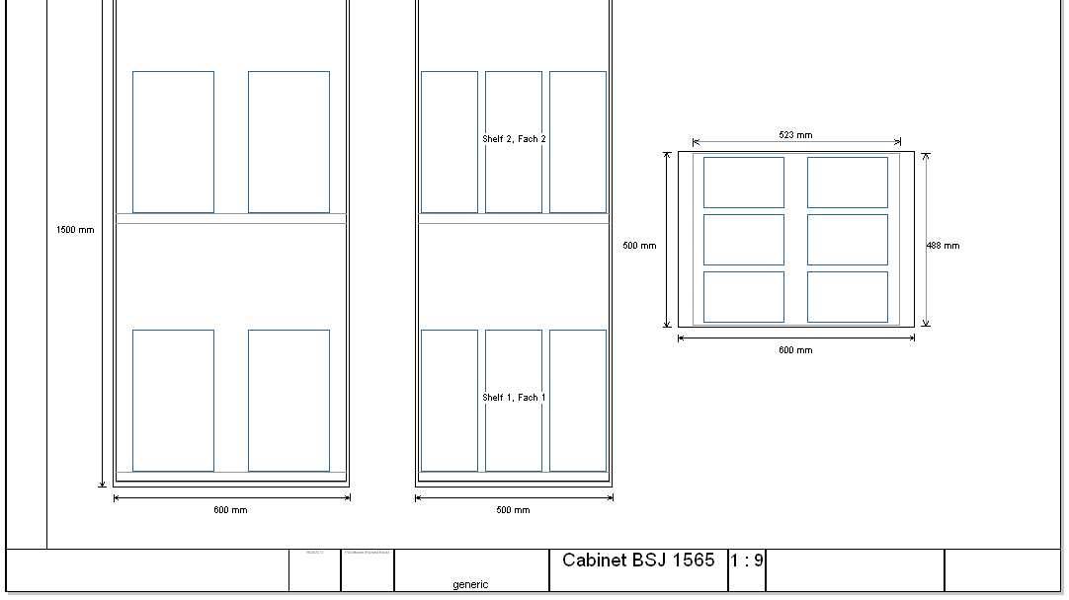
AbacusRack: Documentation
Groundplan drawing
Tehnical drawing for every Rack and Cabinet in use
Dimensions shown
Footer
<Foliennummer>

Slide 7
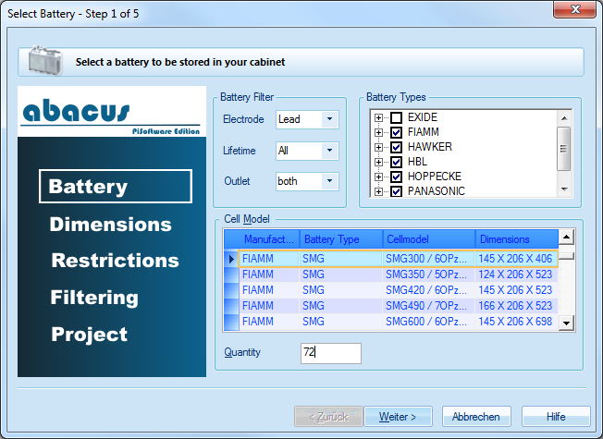
AbacusRack: Sizing Wizard, Battery
Permanent instruction
Select database (e.g. manufacturer)
Clear orientation
Select one or more battery types
Filter for
Battery type
Elektrode type
Life time
Ventilation
Select Cell Model to store
Input number of cells to store
<Foliennummer>

Slide 8
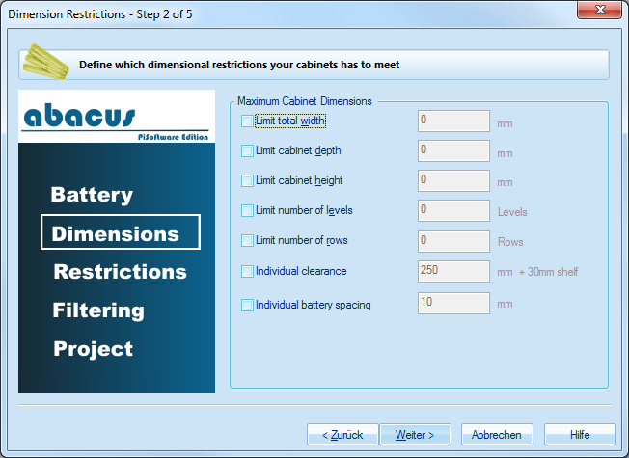
AbacusRack: Sizing Wizard, Dimensions
Restrict usable space
Restrict usable racks and cabinets
Restrict cell parameters
<Foliennummer>

Slide 9
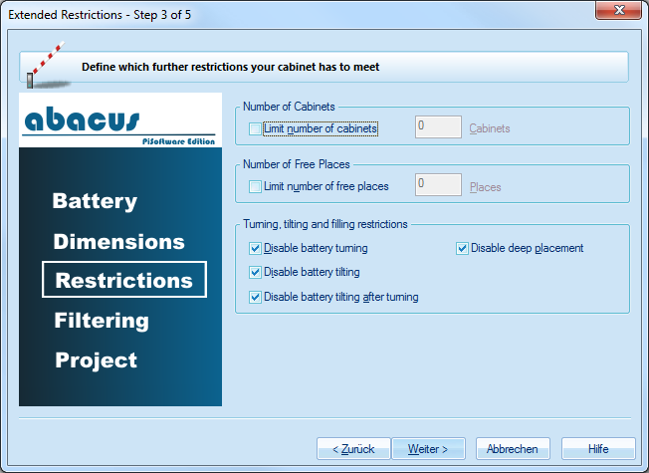
AbacusRack: Sizing Wizard, Restrictions
Restrict number of Racks or Cabinets
Limit unused space
Restrict cell posture
<Foliennummer>

Slide 10
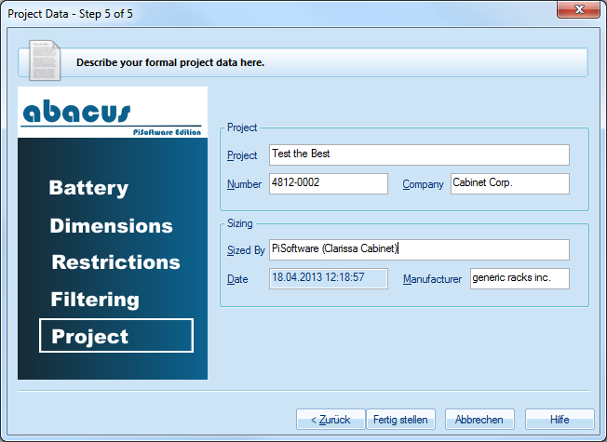
AbacusRack: Sizing Wizard, Project Data
Project Data
User Data
Current Date
<Foliennummer>

Slide 11
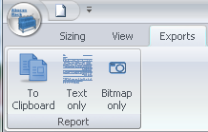
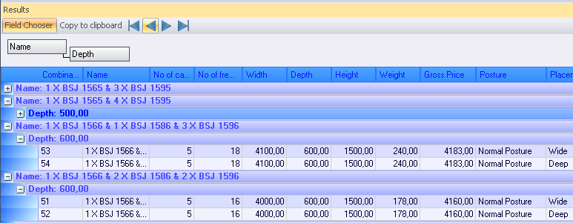
AbacusRack: Exporting
Offer data for word processing
AbacusRack result as Text and Bitmap
Grouped and sorted result list for further work, e.g. in calculation worksheet
<Foliennummer>

Slide 12
Thank you for your interest
Notes:
<Foliennummer>

