Slide 1
abacusCurves
Notes:
<Foliennummer>

Slide 2
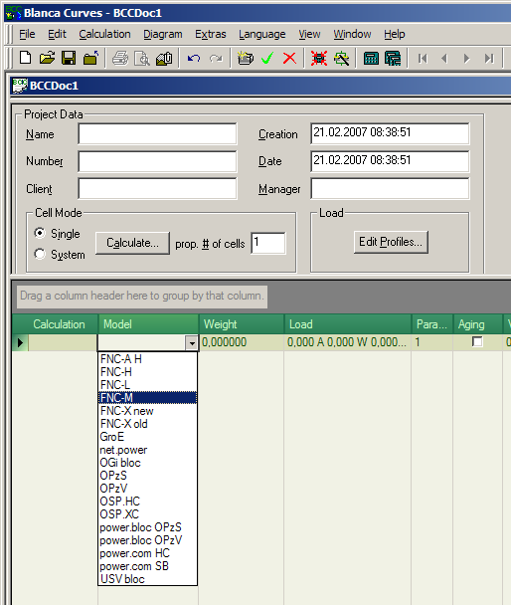
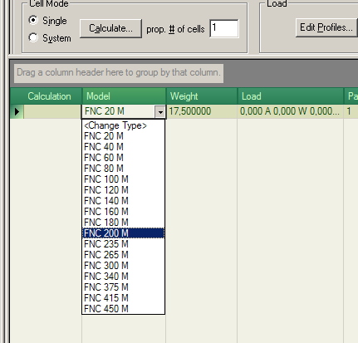
Easy to work with grid to input calculation data
Select Battery Type and Cell Model
Notes:
<Foliennummer>

Slide 3
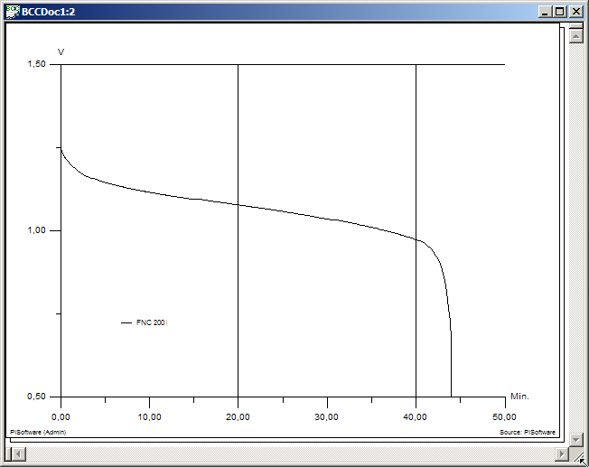
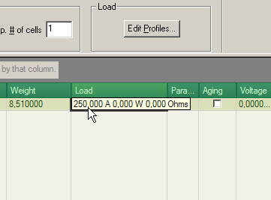
Quick overview of battery's discharge behaviour
Enter Load Value and see Curve instantly
Notes:
<Foliennummer>

Slide 4
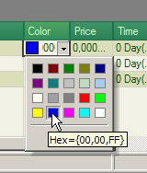
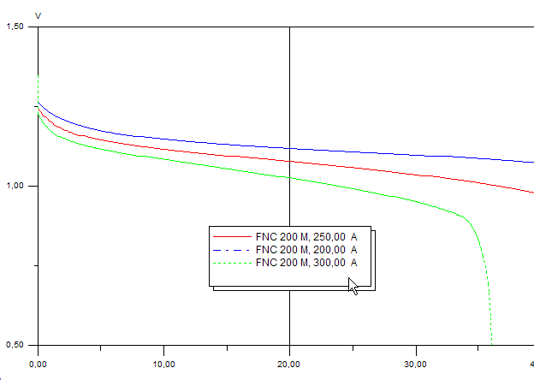
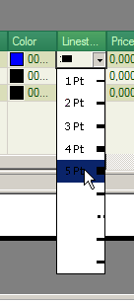
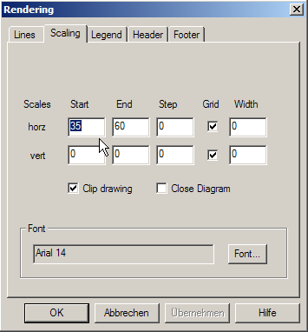
Easily change appearance
Curve colour, Line style, Legends, Scaling
Notes:
<Foliennummer>

Slide 5
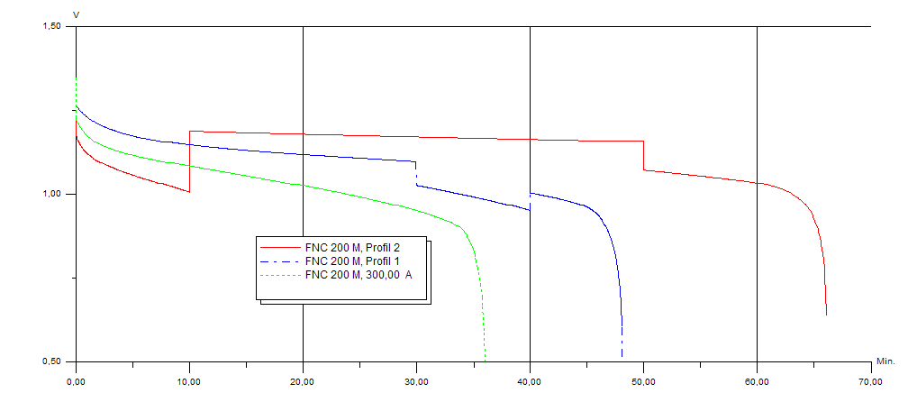
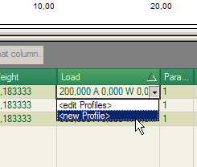
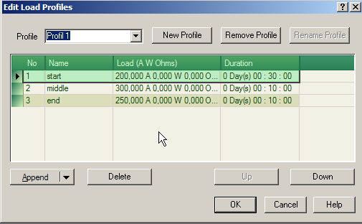
Load Profile editor
Select Editor, enter Data, inspect Result
Notes:
<Foliennummer>

Slide 6
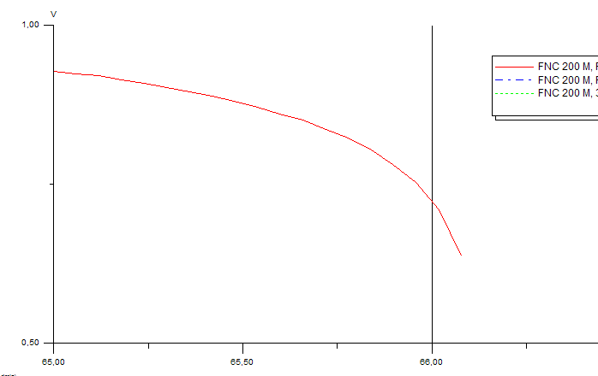
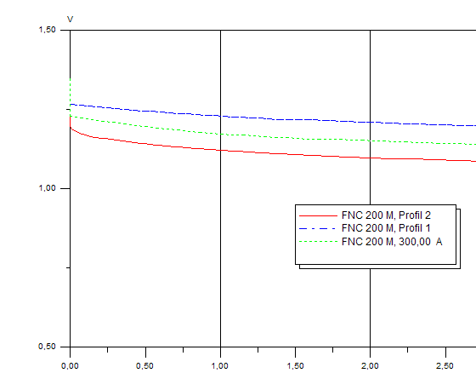
Zoom into crucial Details
Begin of Discharge, End of Discharge
Notes:
<Foliennummer>

Slide 7
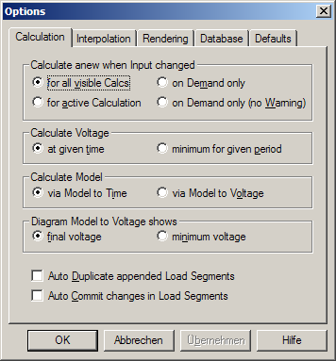
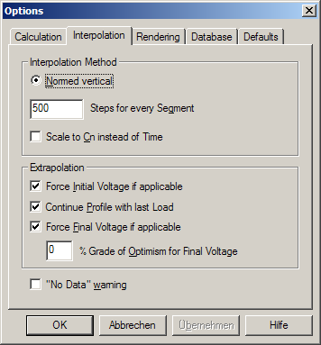
Fine-tune Calculation mode
Calculation & Interpolation issues as well as User Interface
Notes:
<Foliennummer>

Slide 8
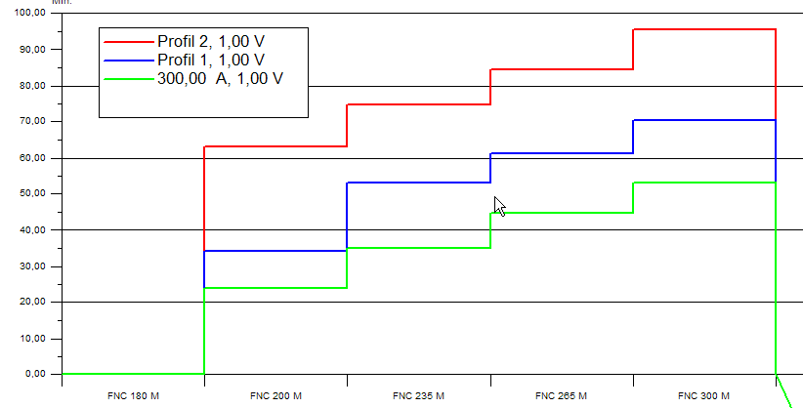
Battery-to-Time diagram
Shows for given End Voltage how long Battery lasts
Notes:
<Foliennummer>

Slide 9
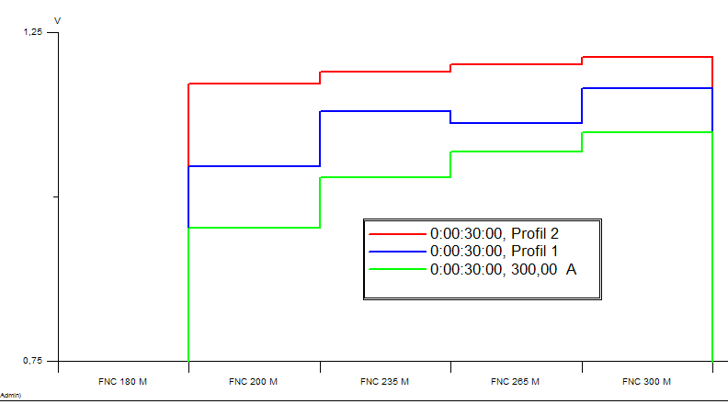
Battery-Voltage diagram
Shows End Voltage for given Discharge Time
Notes:
<Foliennummer>

Slide 10
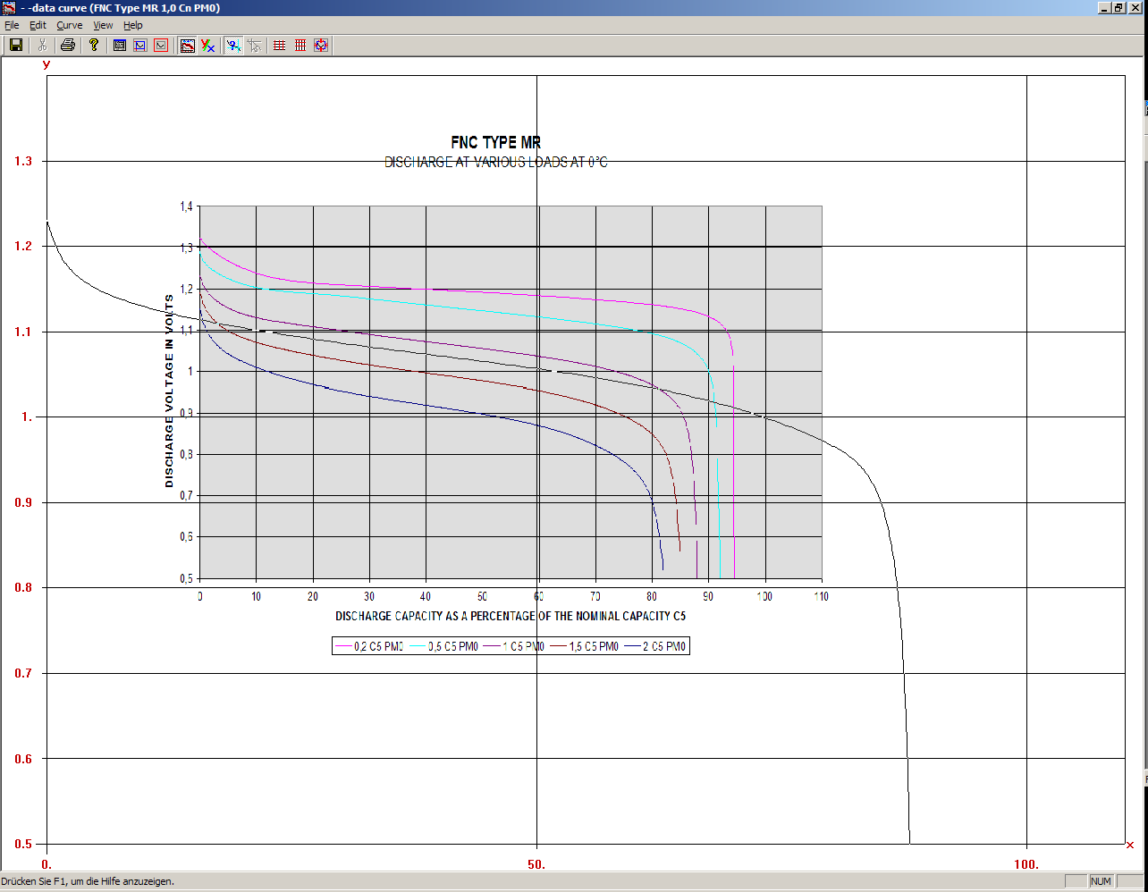
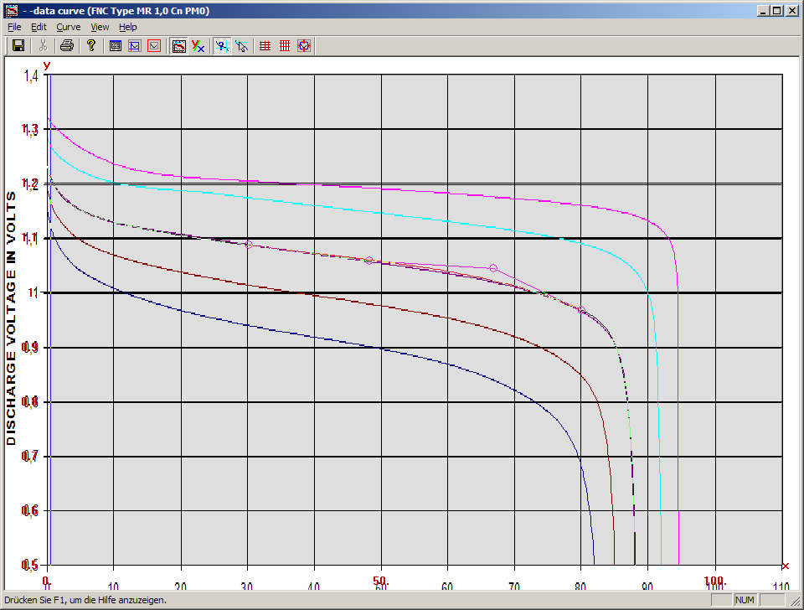
abacusCurves Editor
Import a bitmap and scale it accordingly
Notes:
<Foliennummer>

Slide 11
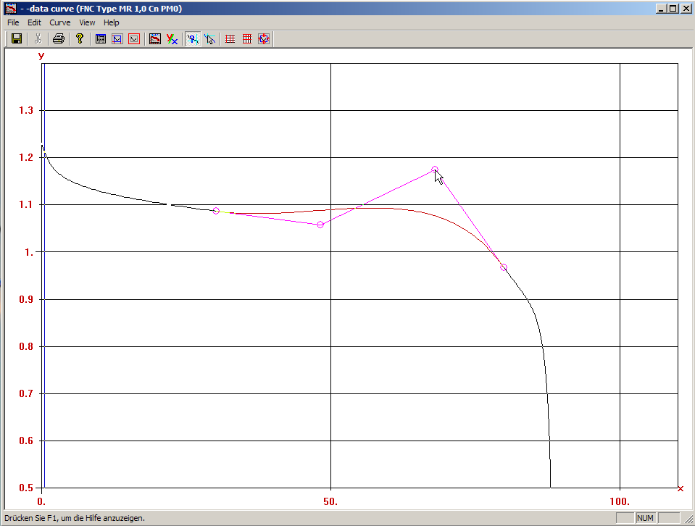
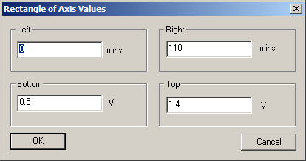
Model Discharge Curves
Using graphic tools and wizard dialogues
Notes:
<Foliennummer>

Slide 12
More diagrams for easy "What-if" scenario work
Time-over-Load shows endurance in relation to applied discharge load
Notes:
<Foliennummer>

Slide 13
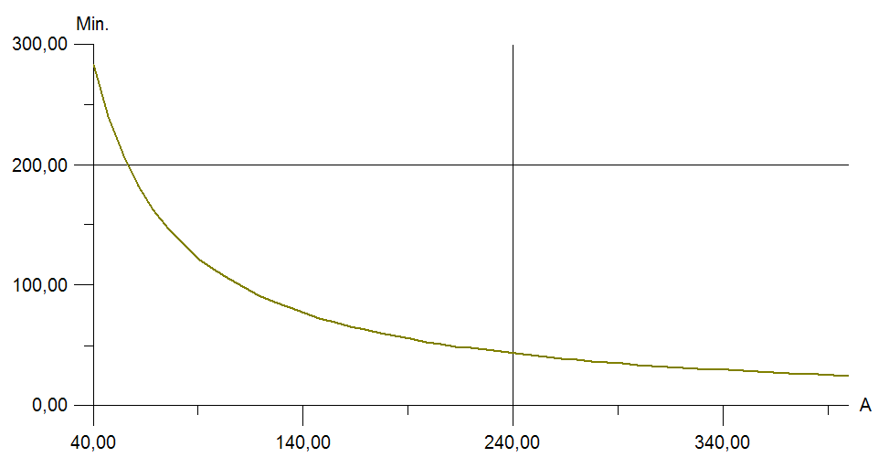
Diagram: Time-over-Load (also called Load-to-Time)
load of 140 Amps allows 75 mins of discharge time
load of 240 Amps only allows 45 mins
Notes:
<Foliennummer>

Slide 14
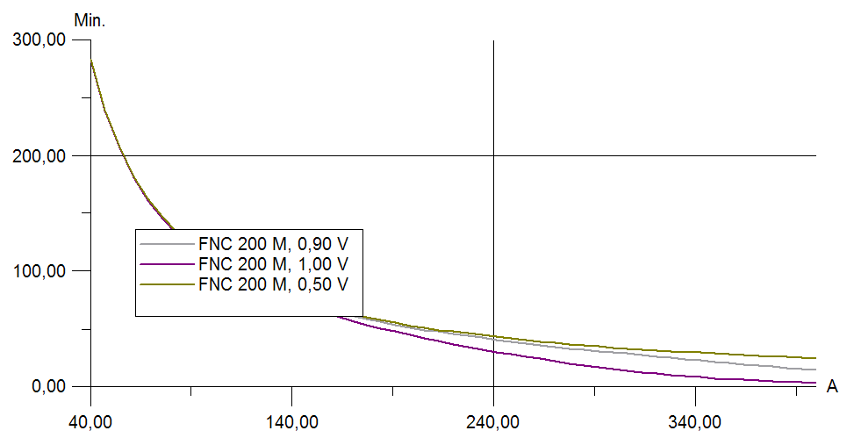
Multiple Time-over-Load HERE: compares end of discharge voltages
higher required end voltage
lower endurance curve
and vice versa
Notes:
<Foliennummer>

Slide 15
More diagrams for easy "What-if" scenario work
Time-over-Load shows endurance in relation to applied discharge load
Load-over-Time shows applicable load in relation to minimum endurance time
Notes:
<Foliennummer>

Slide 16
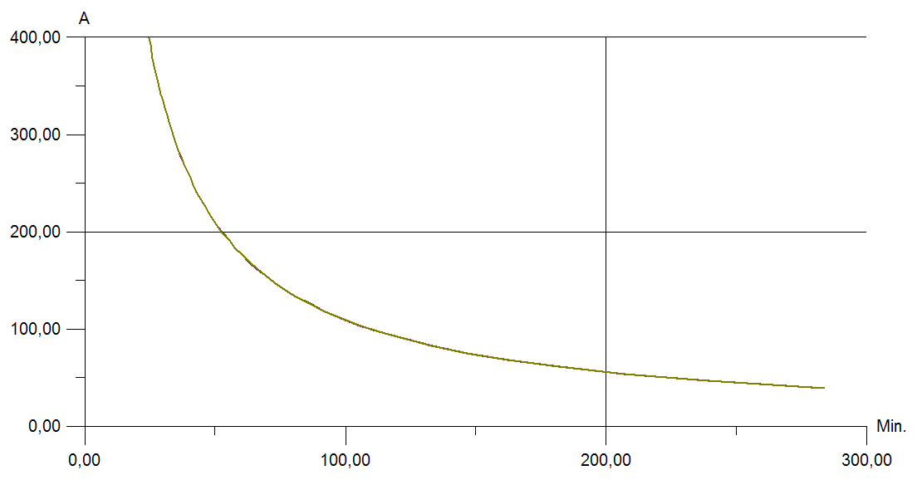
Diagram: Load-over-Time (also called Time-to-Load)
required 100 mins allow load of 115 A
discharge time 200 mins drops max load to 52 A
Notes:
<Foliennummer>

Slide 17
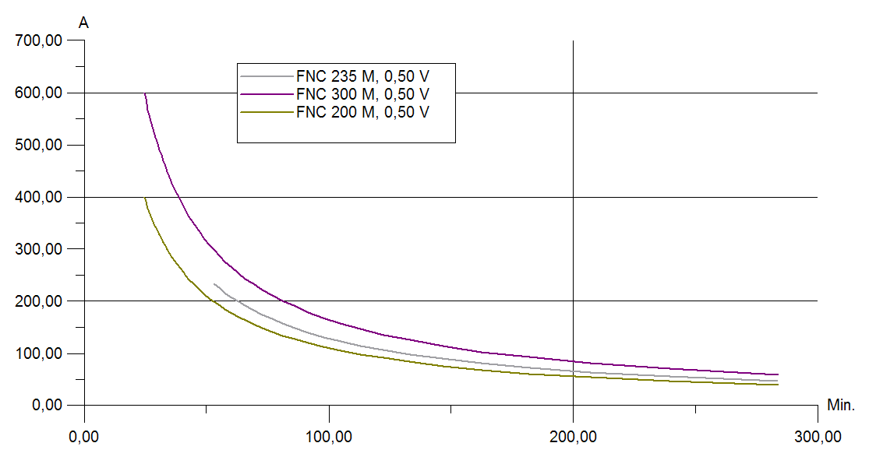
Multiple Load-over-Time HERE: compares battery cell models
bigger battery
and vice versa
allows higher load
Notes:
<Foliennummer>

Slide 18
More diagrams for easy "What-if" scenario work
Time-over-Load shows endurance in relation to applied discharge load
Load-over-Time shows applicable load in relation to minimum endurance time
Voltage-over-Load shows resulting end voltage related to applied load
Notes:
<Foliennummer>

Slide 19
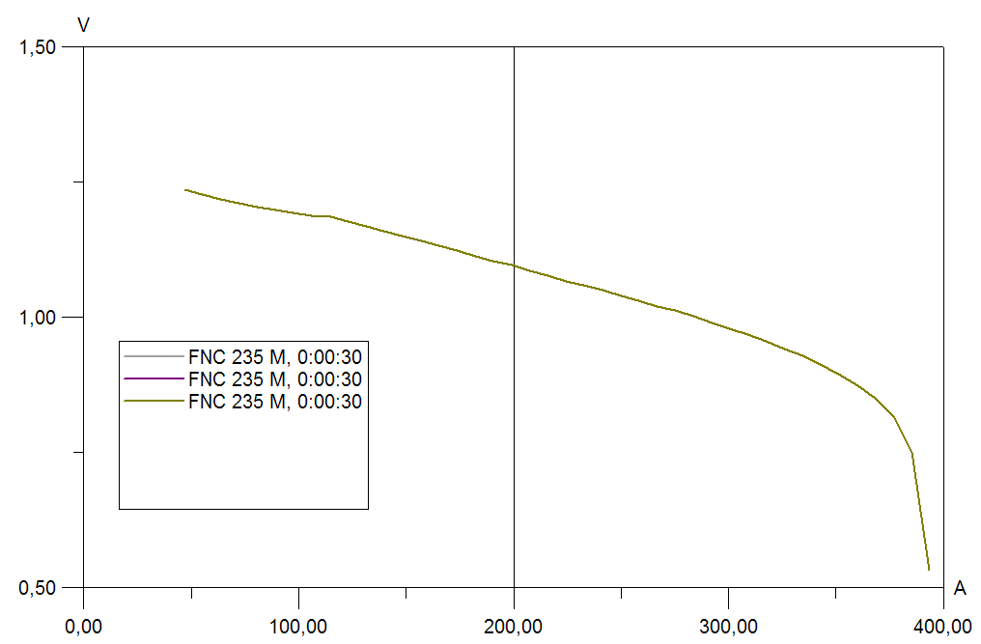
Diagram: Voltage-over-Load (also called Load-to-Voltage)
applied 200 Amps result in 1.10 Volts
applying 300 Amps drops cell to 0.95 V
Notes:
<Foliennummer>

Slide 20
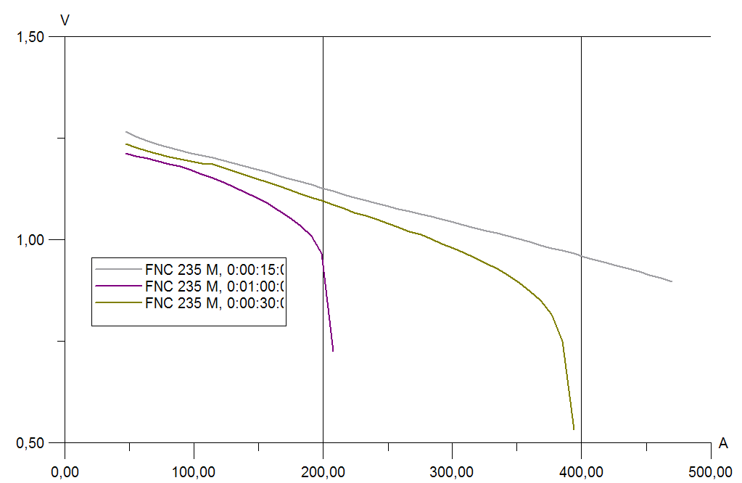
Multiple Voltage-over-Load HERE: compares discharge times
end voltage stays high
short time
and vice versa
Notes:
<Foliennummer>

Slide 21
More diagrams for easy "What-if" scenario work
Time-over-Load shows endurance in relation to applied discharge load
Load-over-Time shows applicable load in relation to minimum endurance time
Voltage-over-Load shows resulting end voltage related to applied load
Load-over-Voltage shows applicable load related to desired end voltage
Notes:
<Foliennummer>

Slide 22
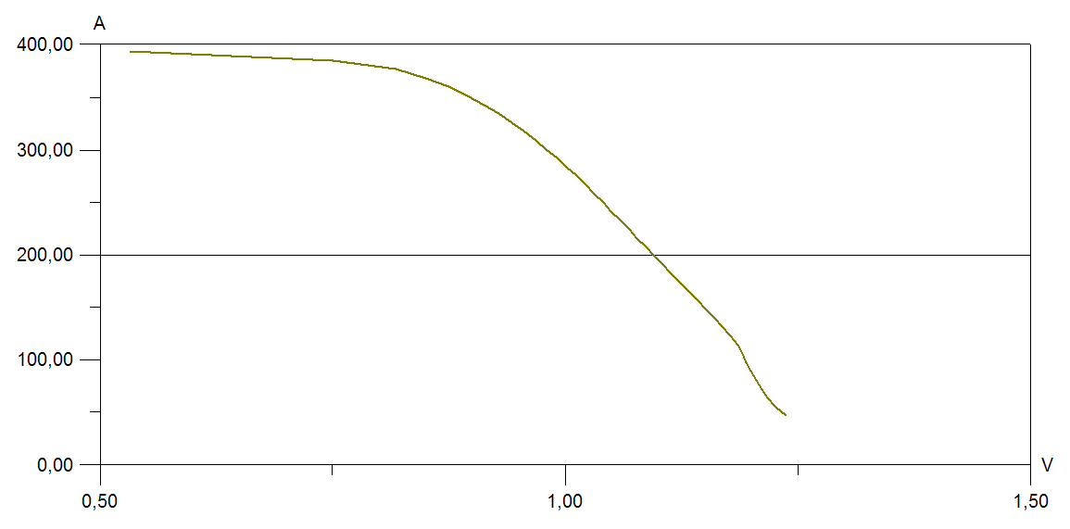
Diagram: Load-over-Voltage (also called Voltage-to-Load)
requiring 1.0 Volts drops load allowance to 280 A
end voltage 0.8 V allows 350 A load
Notes:
<Foliennummer>

Slide 23
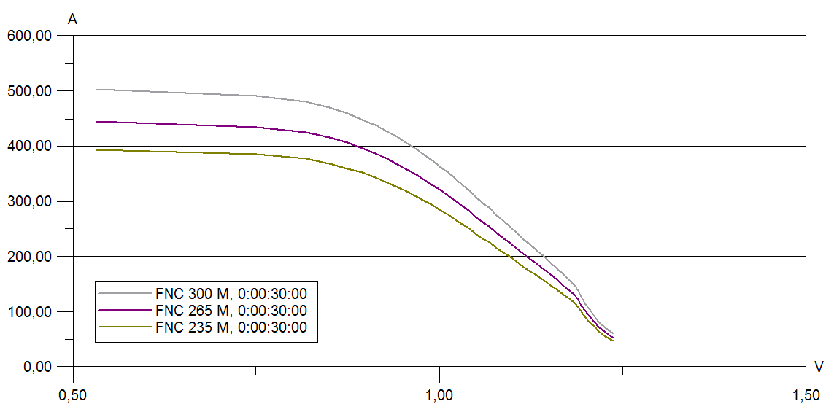
Multiple Load-over-Voltage HERE: compares different cell models
bigger battery
allows higher load
and vice versa
Notes:
<Foliennummer>

Slide 24
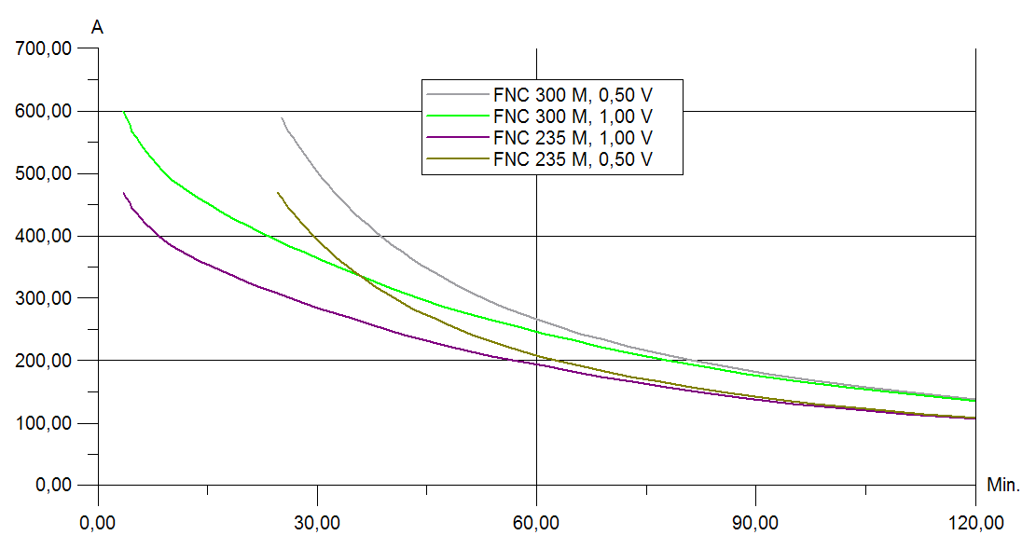
Combining multiple input strategies is possible
Example: Compare different cell models for different required end voltages in one diagram
Notes:
<Foliennummer>

Slide 25
More diagrams for easy cell model comparision
Time-over-Model shows endurance for given load and end voltage
Notes:
<Foliennummer>

Slide 26
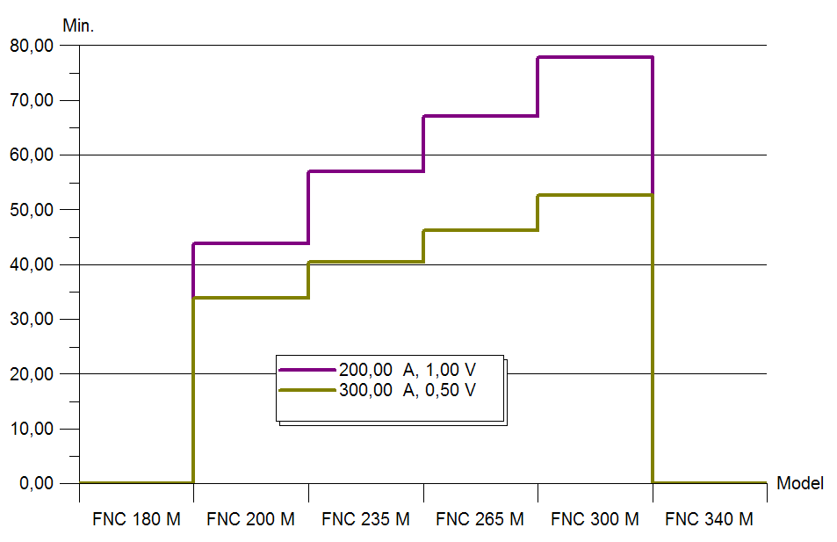
Example: Time-over-Model (also called Model-to-Time)
Notes:
<Foliennummer>

Slide 27
More diagrams for easy cell model comparision
Time-over-Model shows endurance for given load and end voltage
Load-over-Model shows applicable load for given discharge time and end voltage
Notes:
<Foliennummer>

Slide 28
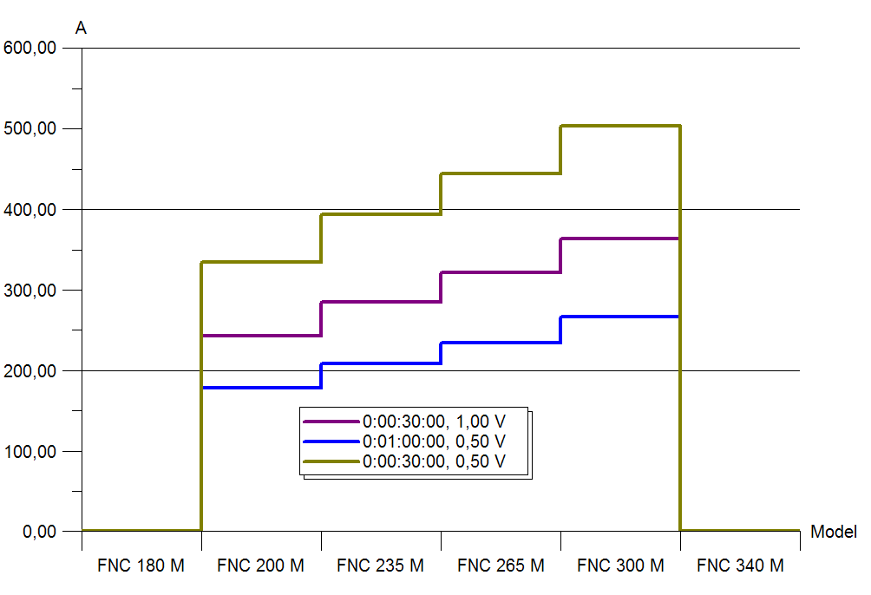
Example: Load-over-Model (also called Model-to-Load)
Notes:
<Foliennummer>

Slide 29
More diagrams for easy cell model comparision
Time-over-Model shows endurance for given load and end voltage
Load-over-Model shows applicable load for given discharge time and end voltage
Voltage-over-Model shows end voltage for given load/time profile
Notes:
<Foliennummer>

Slide 30
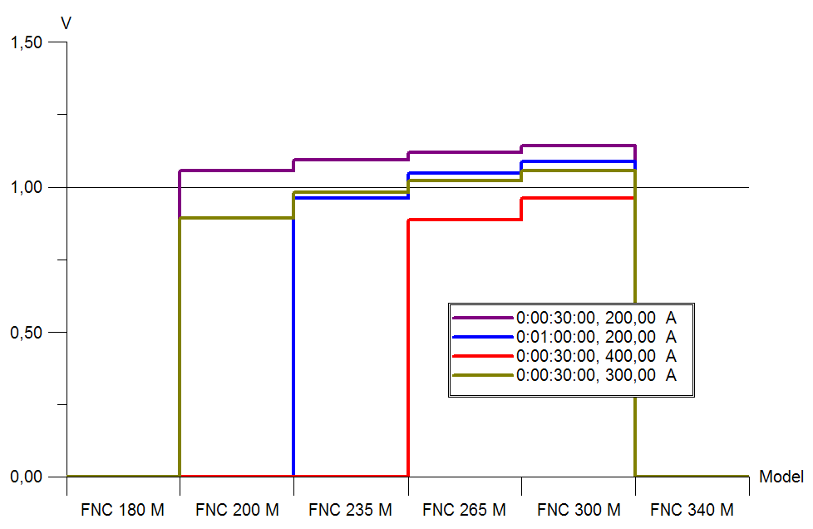
Example: Voltage-over-Model (also called Model-to-Voltage)
Notes:
<Foliennummer>

Slide 31
More diagrams for easy cell model comparision
Time-over-Model shows endurance for given load and end voltage
Load-over-Model shows applicable load for given discharge time and end voltage
Voltage-over-Model shows end voltage for given load/time profile
All diagrams available in mirror form, too
Notes:
<Foliennummer>

Slide 32
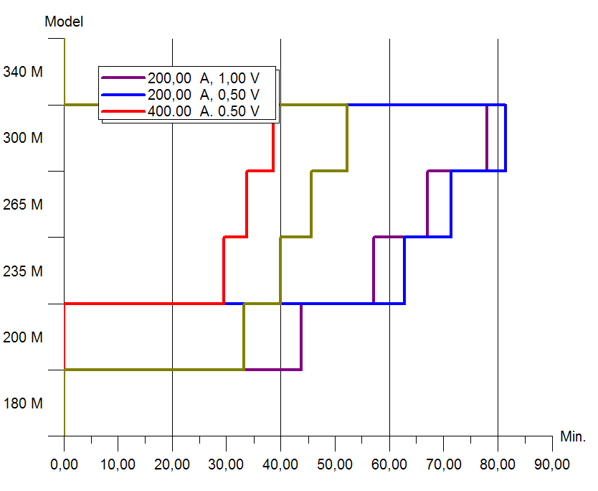
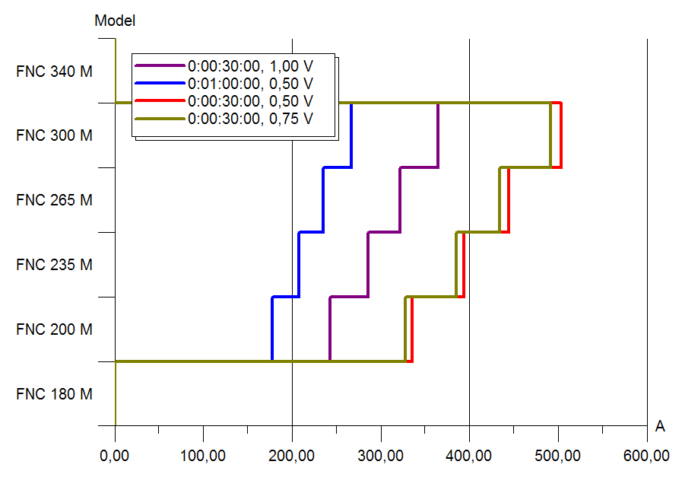
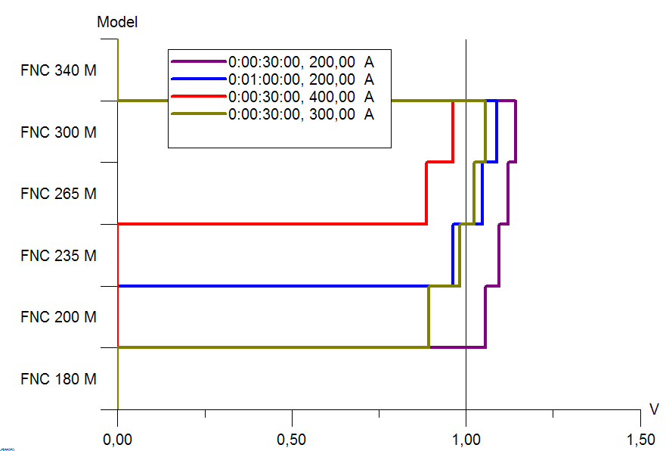
Mirrored Model-to-X Diagrams (also called Model-over-X)
Notes:
<Foliennummer>

